Slide 1

RAJIV GANDHI UNIVERSITY OF KNOWLEDGE TECHNOLOGIES ETCHERLA- SRIKAKULAM (DIST) ANDHRA PRADESH-532410 2023-2024
BACHELOR OF TECHNOLOGY In COMPUTER SCIENCE &
ENGINEERING
Submitted By: Submitted To:
Patro Prameela (S180048) Mrs.S.Lakshmisri (MTech)
JAMI BHUVANASREE (S180073) Assistant Professor
THOTA Jayasri (S180334) CSE Dept.
Ucchula sirisha(s180777)
BYula rani(s180000)

Slide 2
OBJECT DETECTION SYSTEM WITH VOICE ALERT FOR BLIND

Slide 3
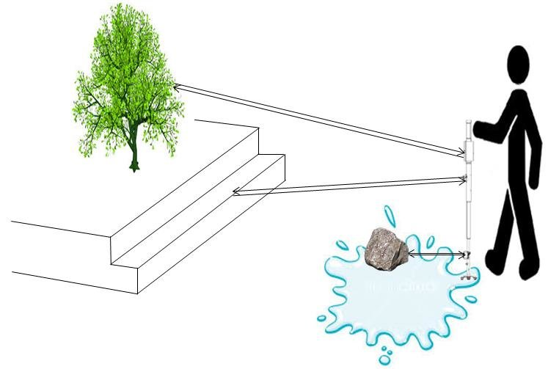
Table of contents
Problem Statement
Abstract
Introduction
Existing System and Disadvantages
Proposed System and Advantages
Objectives
Output
Conclusion
References

Slide 4
Problem statement
In today's advanced hi-tech environment, the need for self-sufficiency is recognised in the situation of visually impaired people who are socially restricted. Visually impaired people encounter challenges and are at a disadvantage as a result of a lack of critical information in the surrounding environment, as visual information is what they lack the most. This project aims to address this issue by proposing an object detection system tailored for the blind, utilizing deep learning techniques. By implementing this system, visually impaired individuals can navigate their surroundings more effectively and autonomously, enhancing their overall independence and safety.

Slide 5
Abstract
As object recognition technology has developed recently, various technologies have been applied to autonomous vehicles, robots, and industrial facilities. This project proposed an object detection system for the blind using deep learning technologies. This system provides voice alerts to the blind, conveying the distance of objects detected in front of them. The object recognition deep learning model utilizes the You Only Look Once(YOLO) algorithm and a voice announcement is synthesized using text-to-speech (TTS) to make it easier for the blind to get information about objects. As a result, it implements an efficient object-detection system that helps the blind find objects in a specific space without help from others, and the system is analyzed through experiments to verify performance.
Keywords: You Look Only Once (YOLO), Text-to-speech (TTS)

Slide 6
Introduction
The visually handicapped can be helped with the use of innovative technologies. This system can recognise items in the environment using voice commands. It may be an effective approach for blind persons to interact with others and may aid with their independence. Those who are wholly or partially blind are considered visually impaired. According to the World Health Organization (WHO), 285 million people worldwide suffer from vision impairment and around 3% of the population of all ages is visually impaired. Visually impaired people go through a lot and encounter a lot of difficulties in their daily lives, such as finding their way and directions, as well as going to places they don't go very often.

Slide 7
Literature survey
This study included the standard datasets as well as an explanation of the current detection model methodologies. This work discussed many detectors, including one-stage and two-stage detectors, which aided in the analysis of various object detection strategies
You only look once: Unified real-time object detection" is a landmark study that was published in the IEEE conference proceedings on computer vision and pattern recognition in 2016. The YOLO (You Only Look Once) technique is described in the paper. It is a unified real-time object detection system that can identify many items in an image within a single neural network forward pass. By dividing the image into a grid of cells, the YOLO algorithm determines the bounding boxes and class probabilities for each cell.
After reviewing numerous studies in the area of pattern recognition, it provides an effective demonstration of the technique for identifying an item and analysing its gesture using machine learning and computer vision for decision-making.

Slide 8
Existing system
SVM Algorithm:
Support Vector Machine (SVM) is employed to automatically characterize and identify objects.
It serves as a binary classifier distinguishing between objects and backgrounds.
SVM aims to accurately detect objects against their backgrounds with minimal training samples.
Limitations:
Not Suitable for Large Datasets: SVM is less effective when dealing with large datasets.
Sensitivity to Noise: Performance may degrade in the presence of noise, impacting accuracy.

Slide 9
CNN Algorithm:
Convolutional Neural Network (CNN) is utilized for identifying objects in images.
The process involves dividing the image into segments and treating each segment as a separate picture.
CNN categorizes these segments into different groups, and then merges them to generate a unified image with detected objects.
Limitations:
Slow Execution: The algorithm's performance is hindered by its slow processing speed.
Time-Consuming: Object detection for an image takes approximately 47 seconds, indicating a lengthy process.
Complex Training: Training the CNN model requires multiple steps and time-consuming training procedures due to various model configurations.
Training Variability: Different models for different tasks contribute to increased training time and complexity.

Slide 10
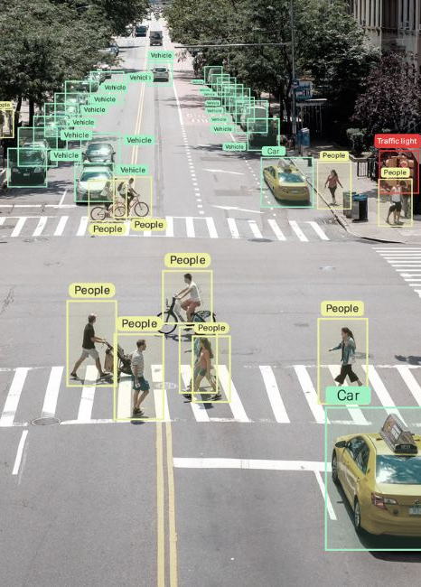
Proposed system
We developed a software-based system that uses the YOLO(You Look Only Once) algorithm for object detection and distance estimation. This algorithm make use of deep convolutional neural networks to identify objects using cameras and to determine their names. The system also uses text-to-speech conversion to help the blind respond to voice commands.

Slide 11
Advantages of proposed system
Fast Object Detection:
The proposed system utilizes the YOLOv4 algorithm, which employs Single Shot Detection (SSD) technique. SSD enables rapid object detection by simultaneously predicting object bounding boxes and class probabilities.
2) No Hardware Devices Required:
Unlike some existing systems that rely on specialized hardware devices such as GPUs for efficient computation, our proposed system operates without the need for additional hardware.
3) Cost-Effectiveness:
The absence of hardware dependencies contributes to the overall cost-effectiveness of the system.
4) Low Power Consumption:
Since the proposed system does not rely on specialized hardware, it consumes significantly lower power compared to systems that require high-performance GPUs.

Slide 12
objectives
Object Detection
Distance Calculation
Voice Alert

Slide 13
Object detection: yolo algorithm
Input Preparation
Feature Extraction
Non-Maximum Suppression
Output Post-Processing
Object Detection

Slide 14
Input Preparation:
YoloV4 prepares input by resizing a picture to a fixed size that is defined in the model setup. After normalising the input image to make sure the pixel values are within a predetermined range, any required pre-processing is then applied.
2. Feature Extraction:
A convolutional neural network (CNN) is used to extract features from the input image. YoloV4's network is based on a fast and effective form of the DarkNet architecture called the DarkNet architecture.
3. Object Detection:
Several detection layers are used to identify objects in the image using the output of the feature extraction network. For objects in the image at various scales and locations, each detection layer forecasts a collection of bounding boxes and related confidence scores.
4. Non-Maximum Suppression:
A Non-Maximum Suppression (NMS) technique is used to filter out overlapping detections and choose the most certain bounding boxes for each object once the detection layers output their predictions
5. Output Post-Processing:
A set of bounding boxes with corresponding class names and confidence ratings for the items found in the input image make up YoloV4's final output.

Slide 15
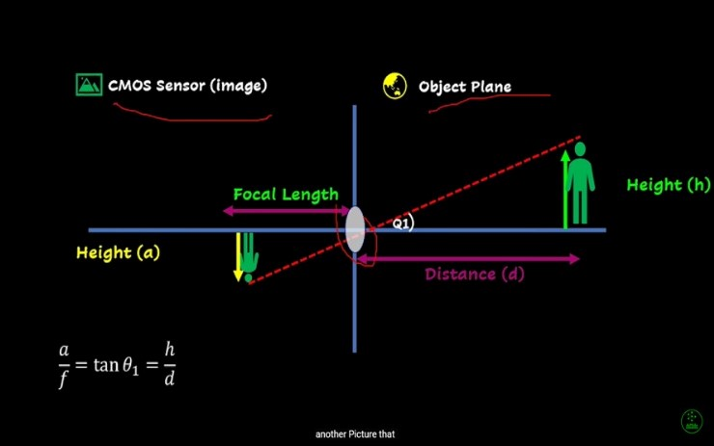
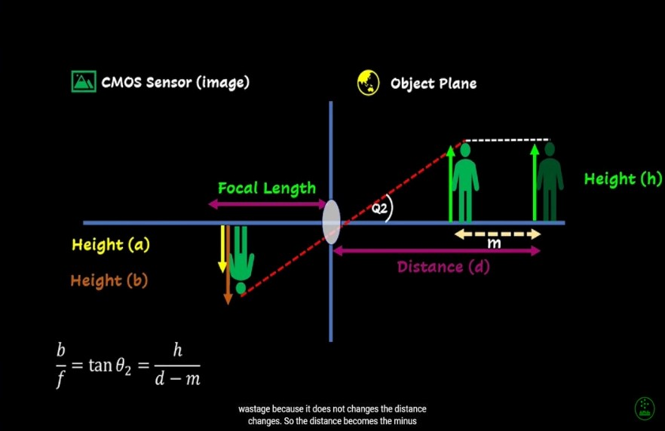
Distance calculation

Slide 16

Metrics for distance
Focal length = $\frac{width in ref image∗known distance}{real width}$
Distance = $\frac{real width∗focal length}{width in frame}$

Slide 17

Text-to-speech conversion
A process known as text-to-speech (TTS) conversion converts written material into spoken words.
TTS conversion normally takes a number of steps. The words, punctuation, and structure of the text are first identified and analysed.
The next step is to break the words down into phonemes, which are the fundamental building blocks of language. The desired speech output is then produced by combining the phonemes.
TTS is a valuable tool for a SELF-WALKING ASSISTANCE FOR BLIND.

Slide 18
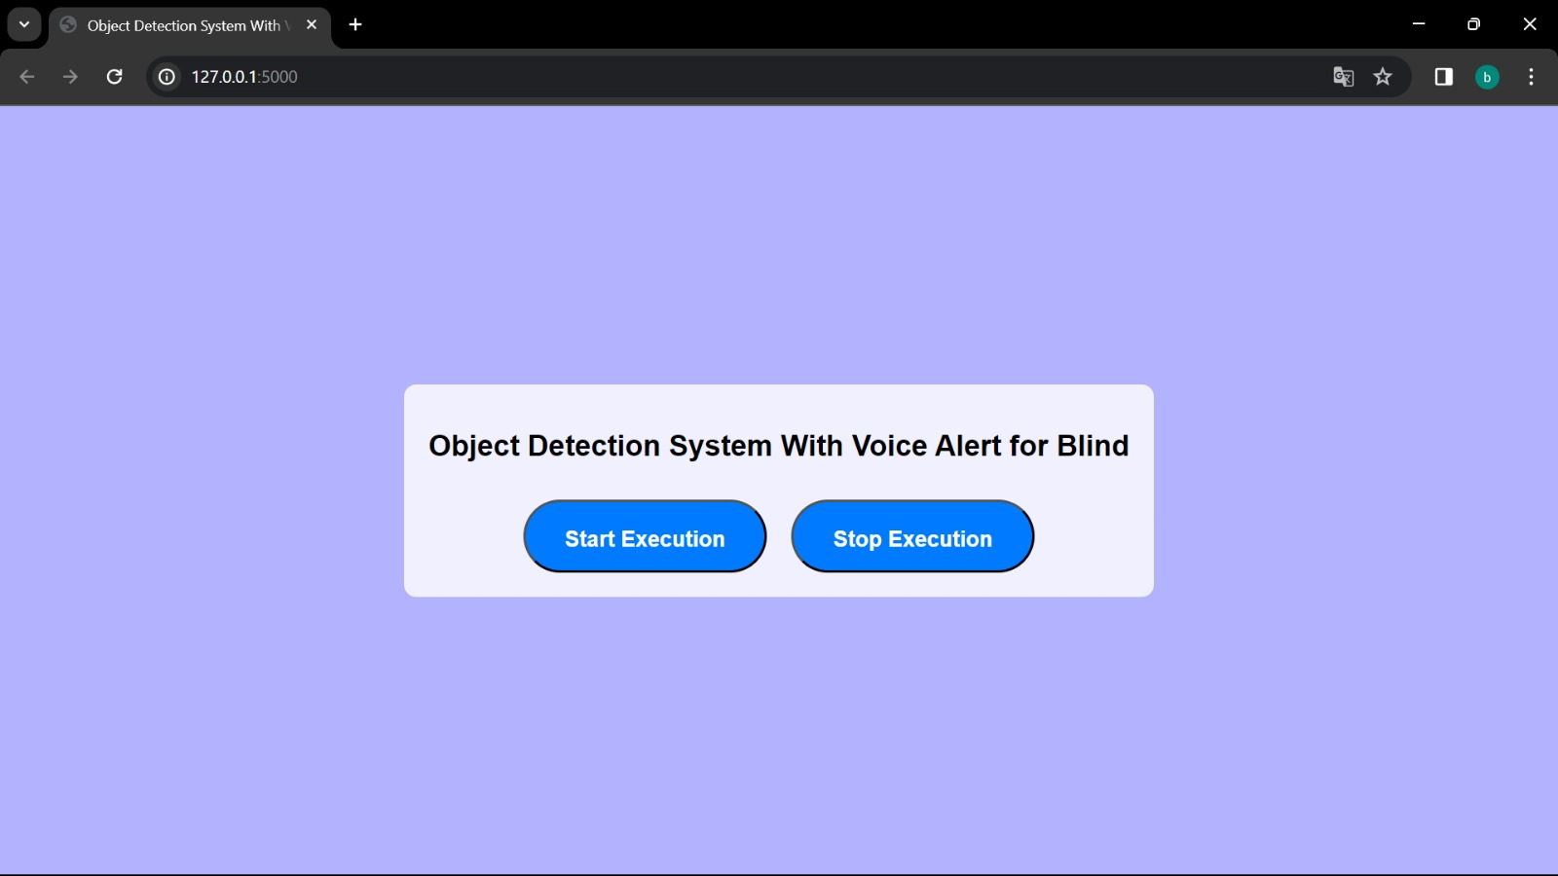
interface

Slide 19
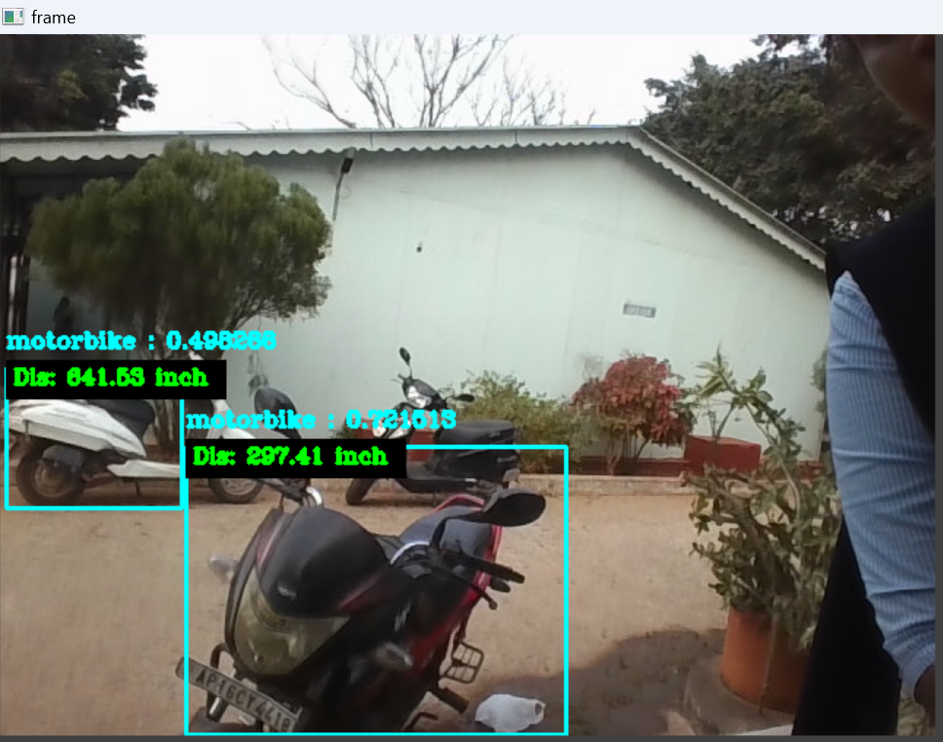
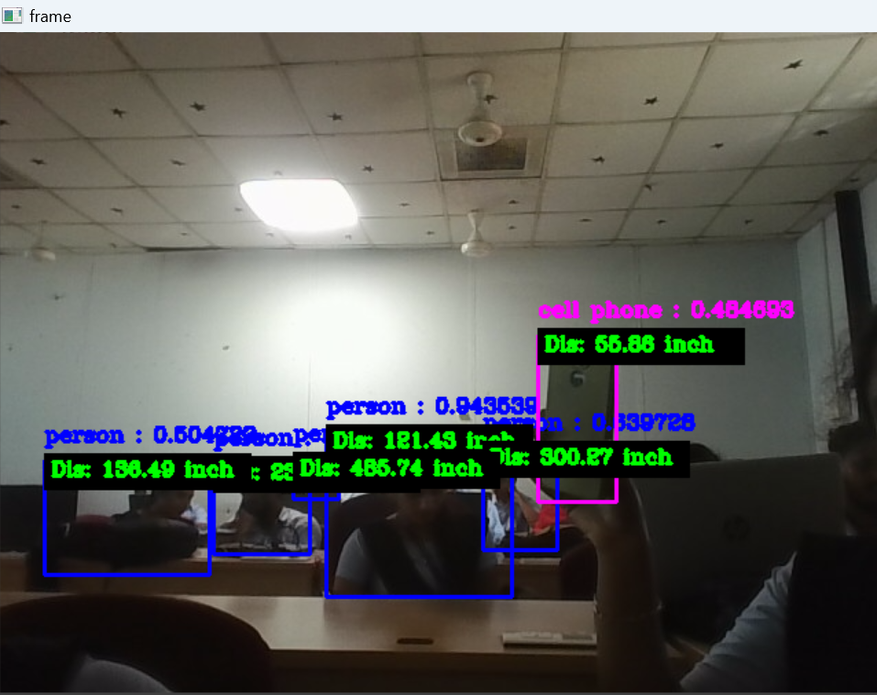
output

Slide 20
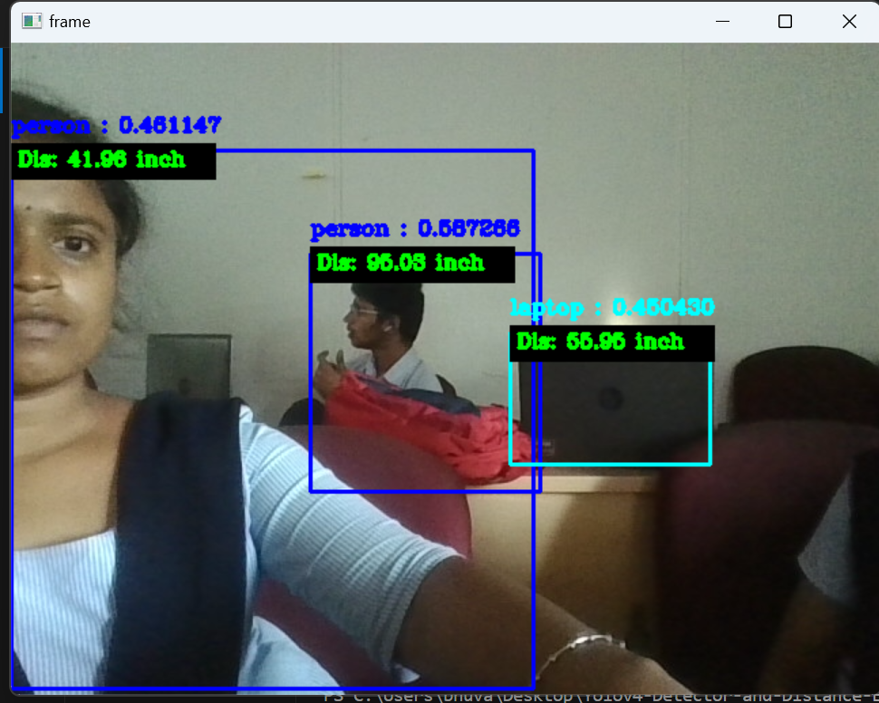
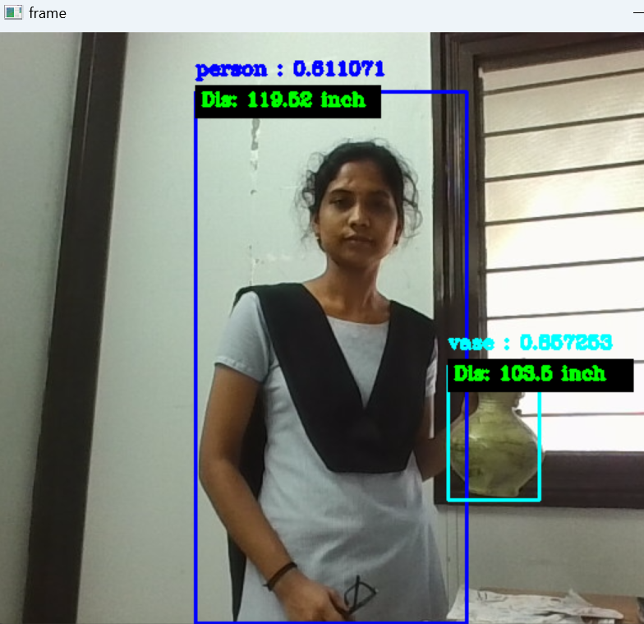

Slide 21
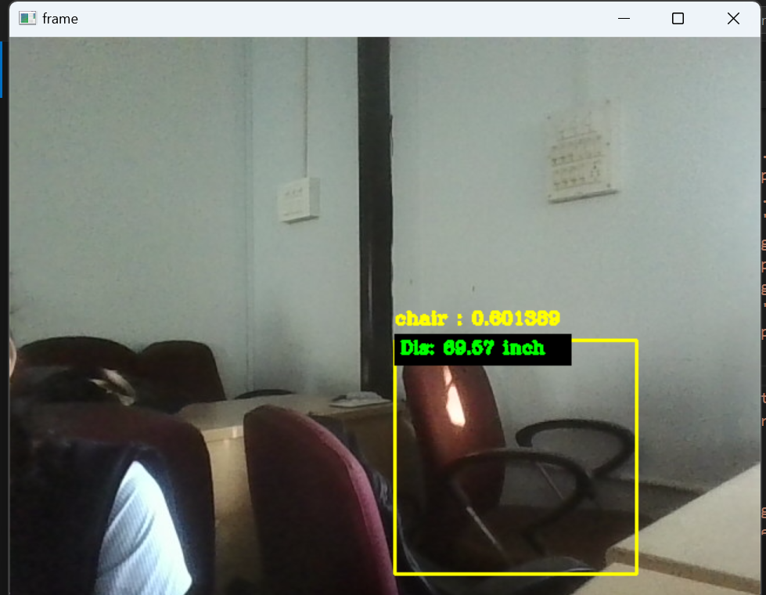
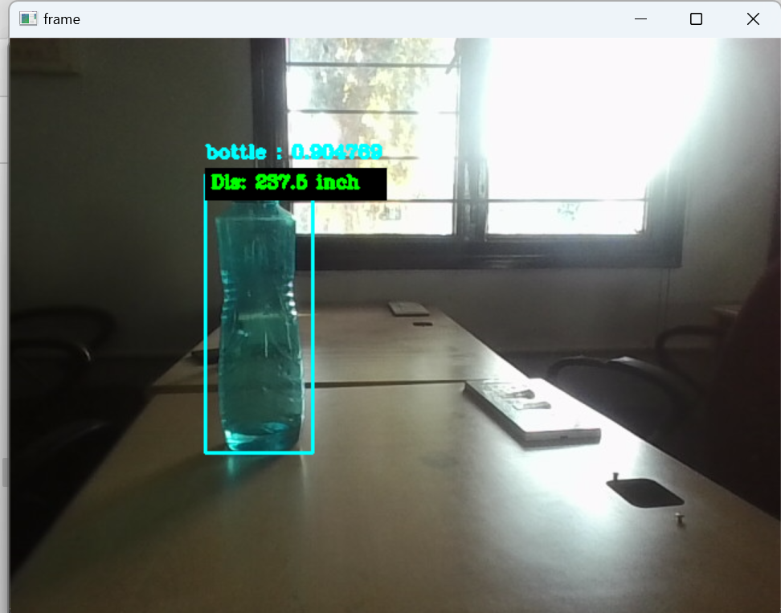

Slide 22
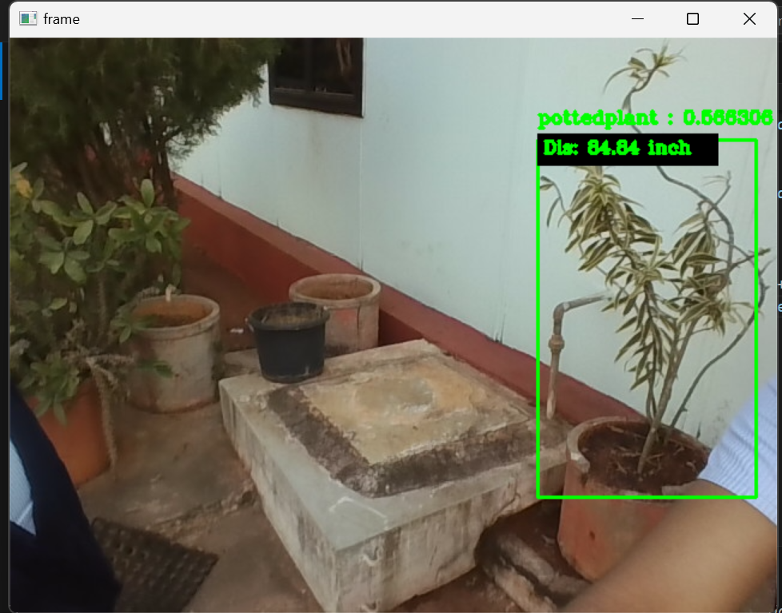
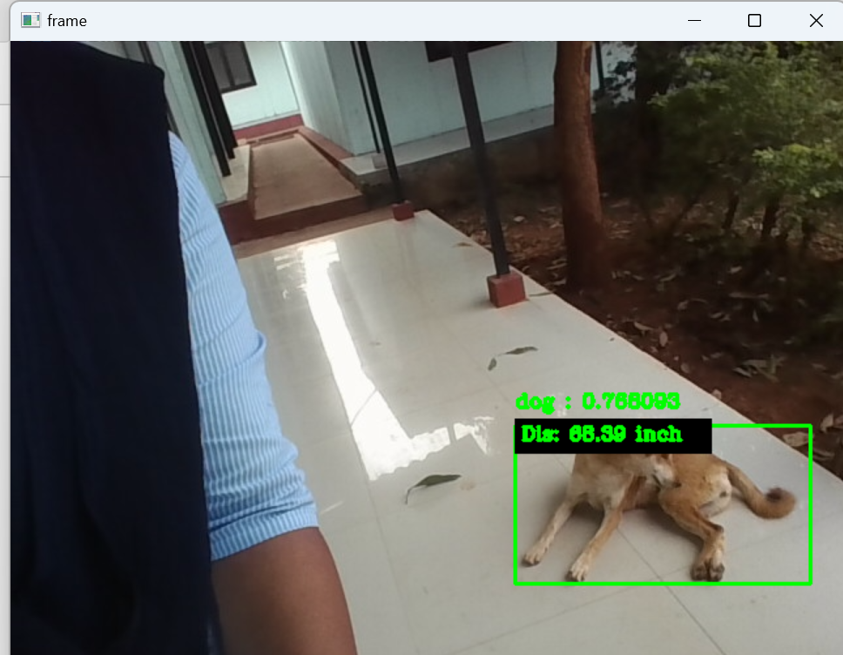

Slide 23

Conclusion
Several technologies have been created to aid visually impaired persons. One such attempt is that we would wish to make an Integrated Machine Learning System that allows the blind victims to identify and classify real-time objects generating voice feedback and distance. Which also produces warnings whether they are very close or far away from the thing. For visually blind folks, this technology gives voice direction. This technique has been introduced specifically to assist blind individuals. The precision, on the other hand, can be improved. Furthermore, the current system is based on the Machine learning, it can be altered to work with any device that is convenient.

Slide 24
References
1] Techniques based on Deep Learning “Electronics and Telecommunications Trends, Vol, 33 No. 4 pp. 23-32, Aug.2018
[2] Joseph redmon, “You Only Look Once: Unified, Real-Time Object Detection,” CVPR 2016.IEEE Computer Society Conference on, pp. 27-30 June 2016.
[3] Aditya Raj, "Model for Object Detection using Computer Vision and Machine Learning for Decision Making," International Journal of Computer Applications, 2019.
[4] Bhumika Gupta, "Study on Object Detection using Open CV Python," International Journal of Computer Applications Foundation of Computer Science, vol. 162, 2017.

Slide 25


